Slide 1
Knowing The What But Not The Where in Bayesian Optimization
Vu Nguyen, Michael A Osborne
Digital Twin｜DRC｜07/12/2022
彭家祐 (Jack) Intern

Slide 2
Introduction
Motivation：In some settings, the optimum output f* = f (x*) is known (e.g. optimum accuracy is 100 in tuning classification algorithm)
Goal：exploit the knowledge about f* to search for the input x* efficiently (how to efficiently utilize such prior knowledge to find the optimal inputs using the fewest number of queries)
Method
use the knowledge of f* to build a transformed GP surrogate model
proposed two novel acquisition functions (confidence bound minimization & expected regret minimization)
Contribution
a first study of Bayesian optimization for exploiting the known optimum output f*
a transformed Gaussian process surrogate using the knowledge of f*
two novel acquisition functions to efficiently select the optimum location given f*

Slide 3


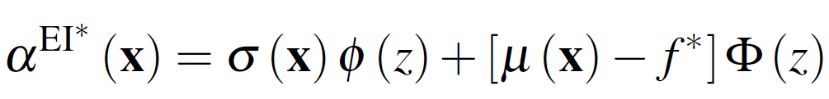
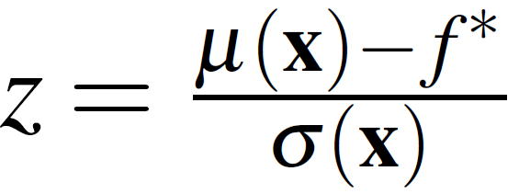
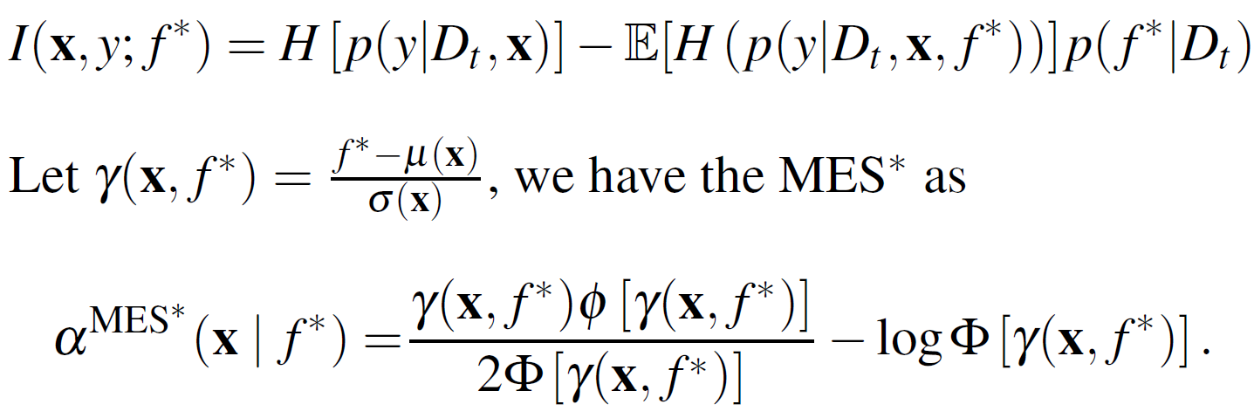
Available acquisition functions for the known f*
Expected improvement with known incumbent f* (Wang & de Freitas, 2014; Berk et al., 2018)
Typical choice of the incumbent is the best observed value so far in the observation set
Given the known optimum output f*, one can readily use it as the incumbent
Output entropy search with known f* (Wang & Jegelka,2017)
Given the known f* value, MES (Max-value Entropy Search) approximates I(x,y; f*) using a truncated Gaussian distribution such that the distribution of y needs to satisfy y < f*

Slide 4
Gaussian process transformation for f $≤$ f*
Transformation with sigmoid or tanh …
problem
need to know lower and upper bound of f(x), but we do not know the lower bound in the setting
Under these transformations will become the Gaussian process classification problem
Transform the output of a GP using warping
Problem
Less efficient
Requires more data points
Linearization trick
ensures that we arrive at another GP after transformation given our existing GP
In this paper, we shall follow this linearization trick to transform the surrogate model given f*
L(x) = f(a) + f ’(a) (x-a)

Slide 5
Gaussian process transformation for f $≤$ f*
Transformation with sigmoid or tanh …
problem
need to know lower and upper bound of f(x), but we do not know the lower bound in the setting
Under these transformations will become the Gaussian process classification problem
Transform the output of a GP using warping
Problem
Less efficient
Requires more data points
Linearization trick
ensures that we arrive at another GP after transformation given our existing GP
In this paper, we shall follow this linearization trick to transform the surrogate model given f*
L(x) = f(a) + f ’(a) (x-a)

Slide 6
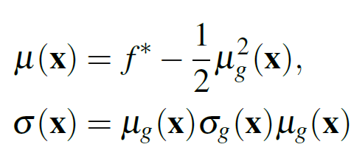




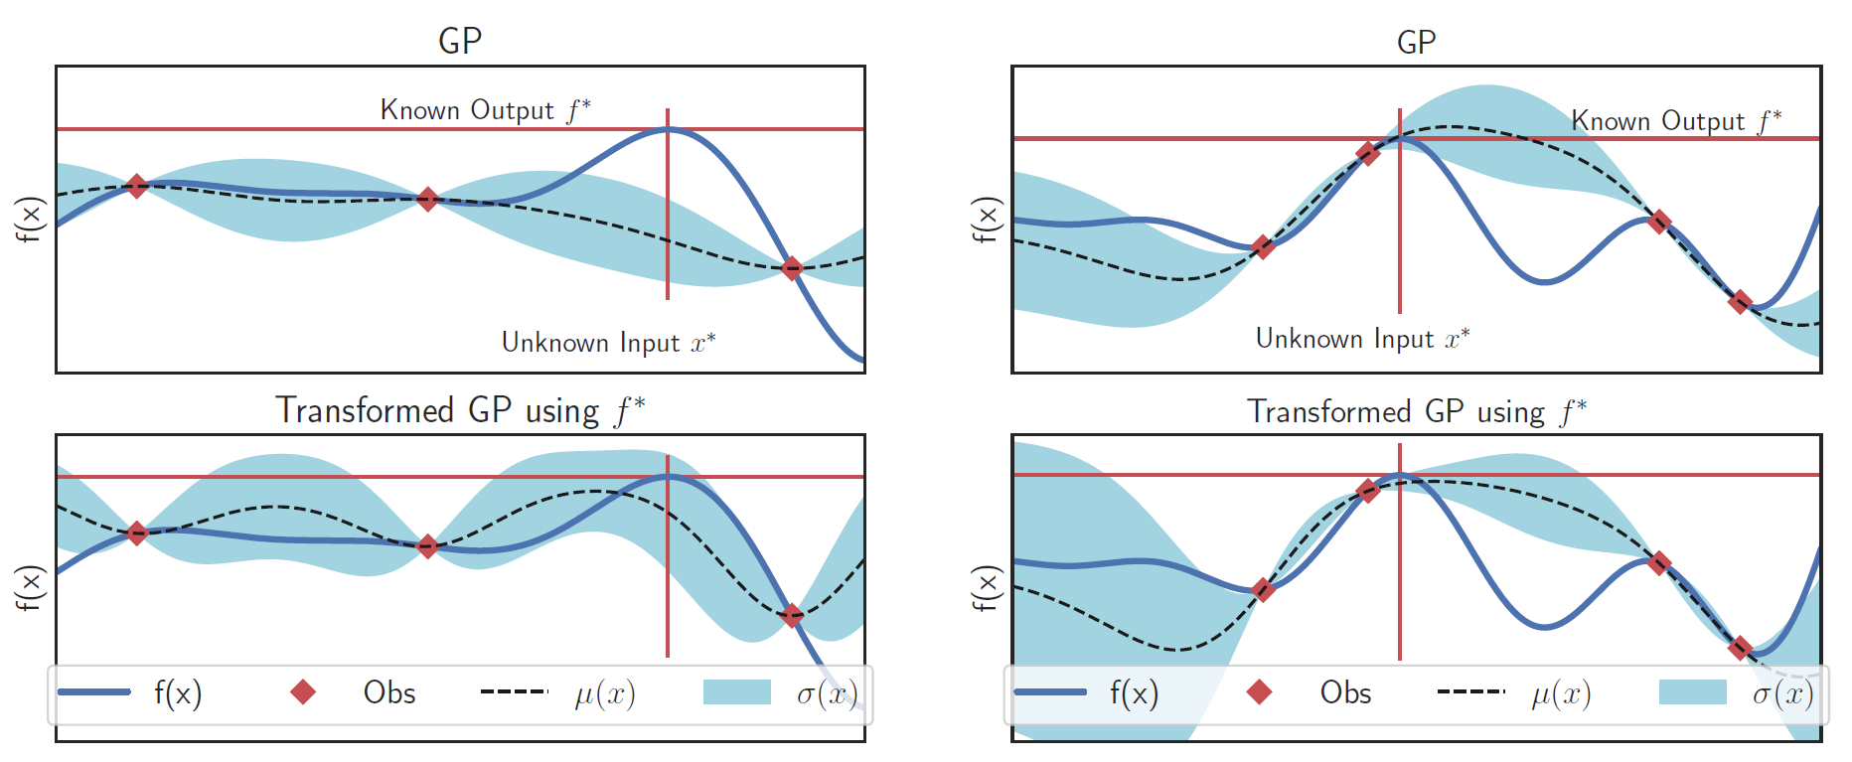
Proposed Method - Transformed GP (2/2)
Transformed Gaussian process
Linear transformation of a GP remains GP, the predictive posterior distribution for f has a closed form：
Effect of the transformation：predictive uncertainty becomes larger than normal GP where is low → let some acquisition functions (e.g., UCB, EI) explore more aggressively
Transformed GP compared with normal GP
transforming the GP using f*, we encode the knowledge about f* into the surrogate model
Transformed GP Surrogate model gets close to optimum output f* but never above f*

Slide 7



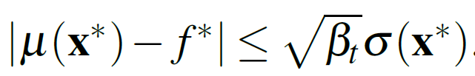
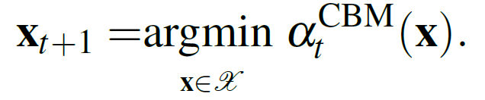
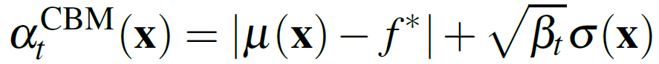


Proposed Method - Confidence bound minimization
GP surrogate at any location x with high probability：
is a hyperparameter. Given the knowledge of f *, we can express this property at the optimum location x* where to have w.h.p
Selecting next point by taking
Take the minimum value at ideal location where ,
Has hyperparameter , to which performance can be sensitive → propose another acquisition function incorporating the knowledge of f* using no hyperparameter

Slide 8
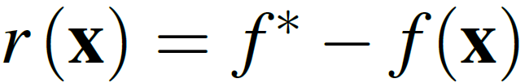
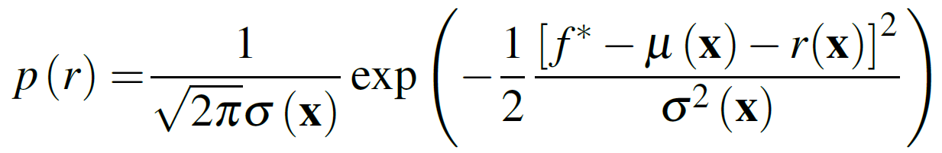

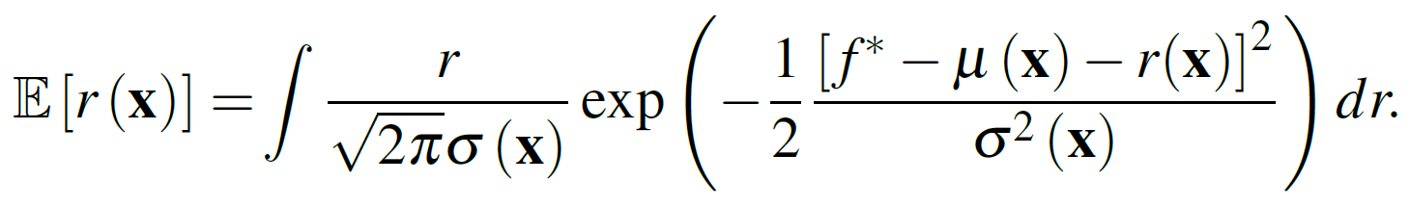
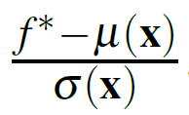
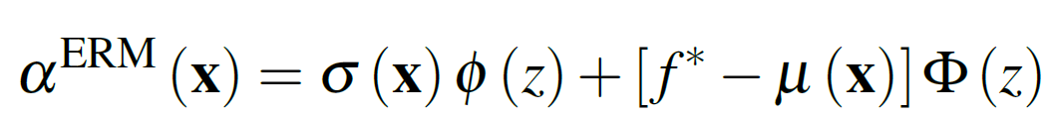
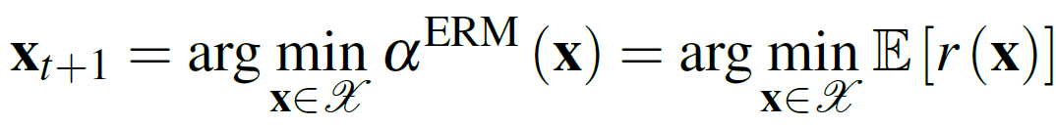


Proposed Method - Expected regret minimization
Start with the regret function
The probability of regret r(x) on a normal posterior distribution：
acquisition function to minimize this expected regret as
Let z = , we obtain the closed-form computation as
select the next point, we minimize this acquisition function which is equivalent to minimizing the expected regret
Take the minimum value at ideal location where ,
Original EI prefer high GP mean and variance (is to balance exploitation and exploration)
ERM selects the point to minimize expected regret with → f* with low variance

Slide 9


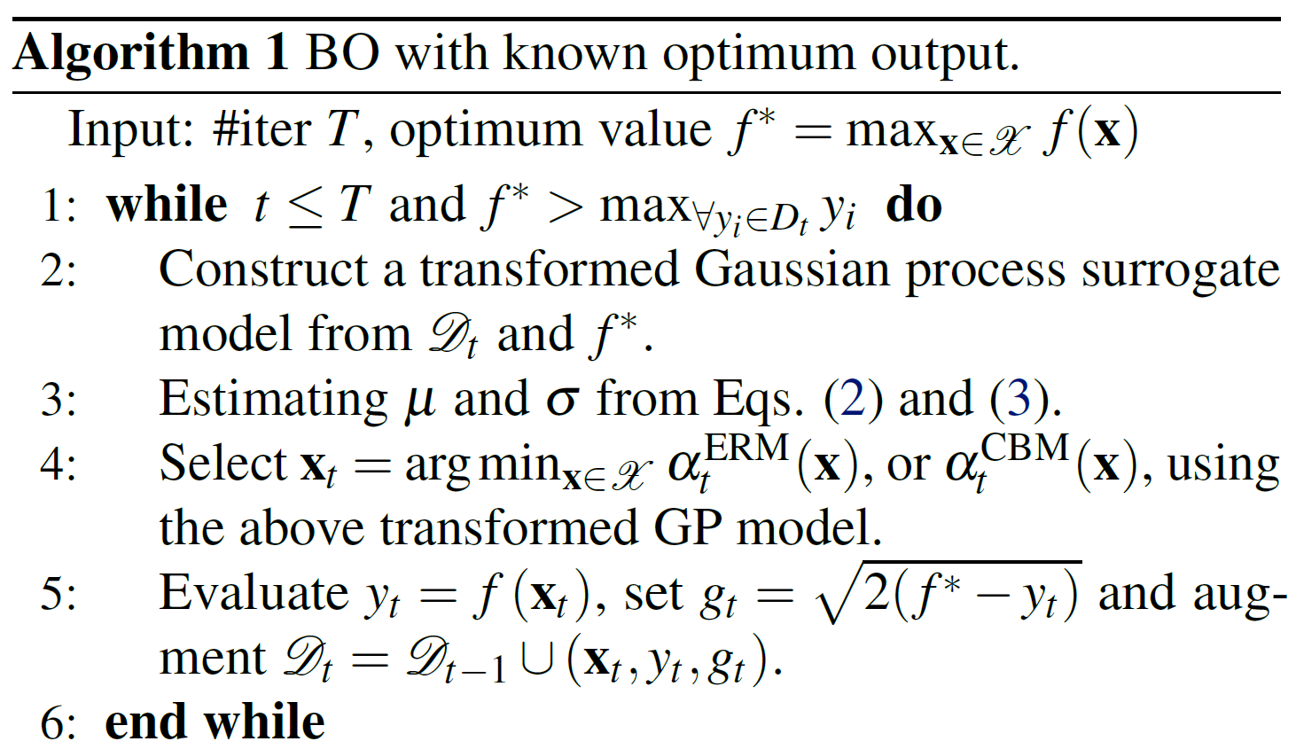
Algorithm – BO with known optimum output
Given original observation and f*, compute to build a transformed GP
Using transformed GP, predict the mean and variance at any location x
compute the CBM and ERM acquisition functions to select next point

Slide 10
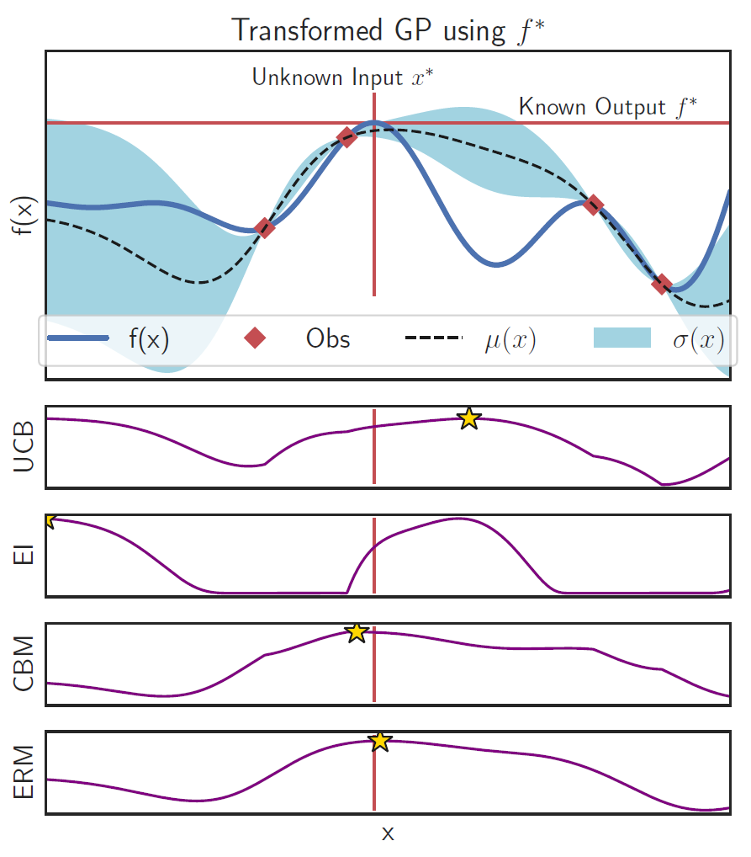
Experiment – Comparison of Acquisition function
CBM and ERM will select the location where the GP mean m(x) is close to the optimal value f* and we are highly certain about it (low )
UCB and EI will always keep exploring as the principle of explore-exploit without using the knowledge of f*
UCB and EI can not identify the unknown location x efficiently as opposed to proposed acquisition functions

Slide 11
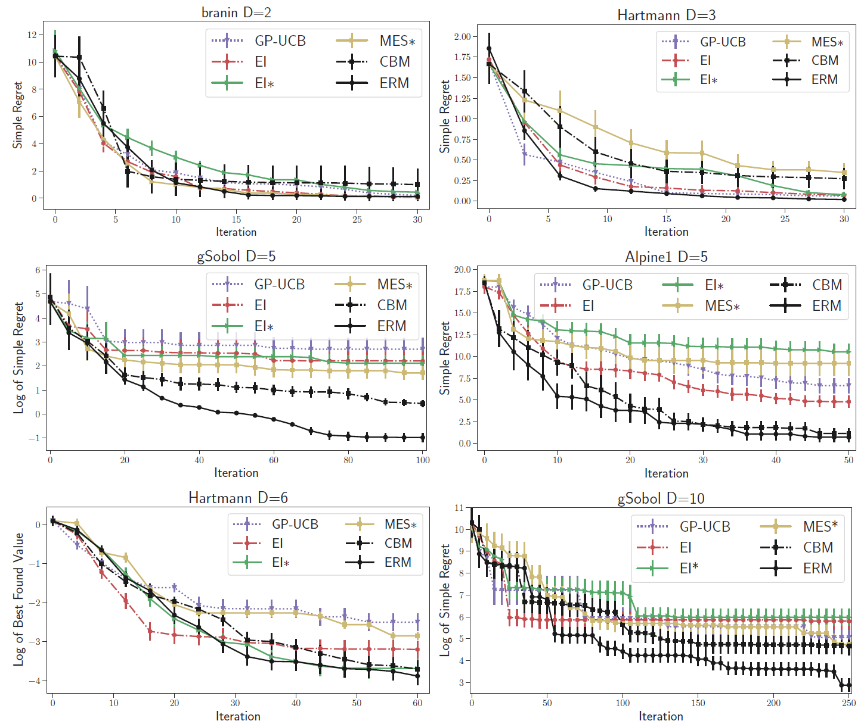
Experiment – 6 Benchmark functions given f *
Proposed framework has utilized the additional knowledge of f* to build an informed surrogate model and decision functions
ERM outperforms all methods by a wide margin.
CBM can be sensitive to the hyperparameter, ERM has no parameter and is thus more robust
approaches with f* perform significantly better than the baselines in gSobol and Alpine1 functions.
The results indicate that the knowledge of f* is particularly useful for high dimensional functions.

Slide 12
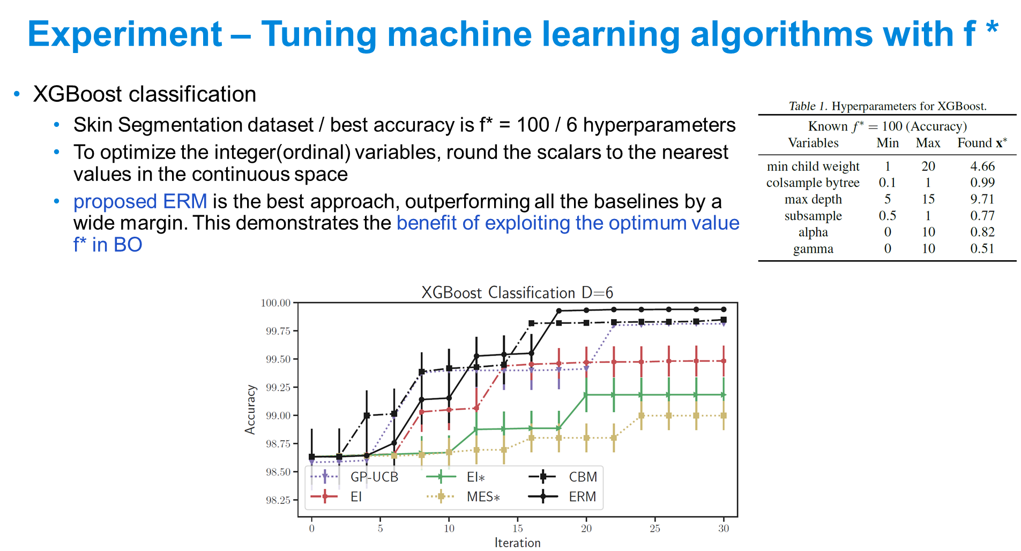

Slide 13
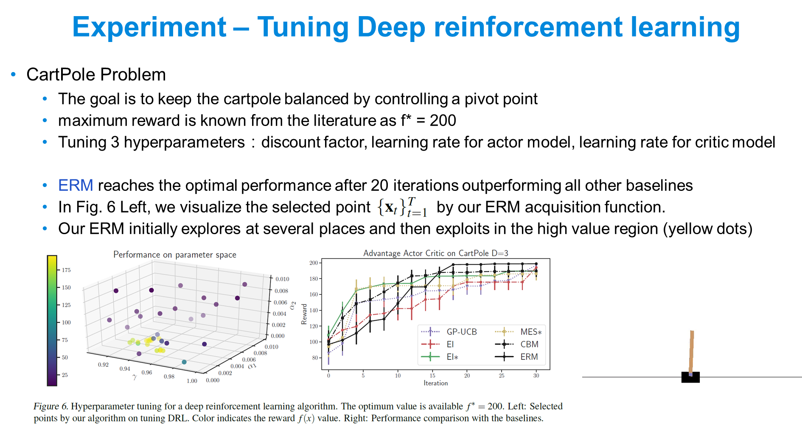

Slide 14
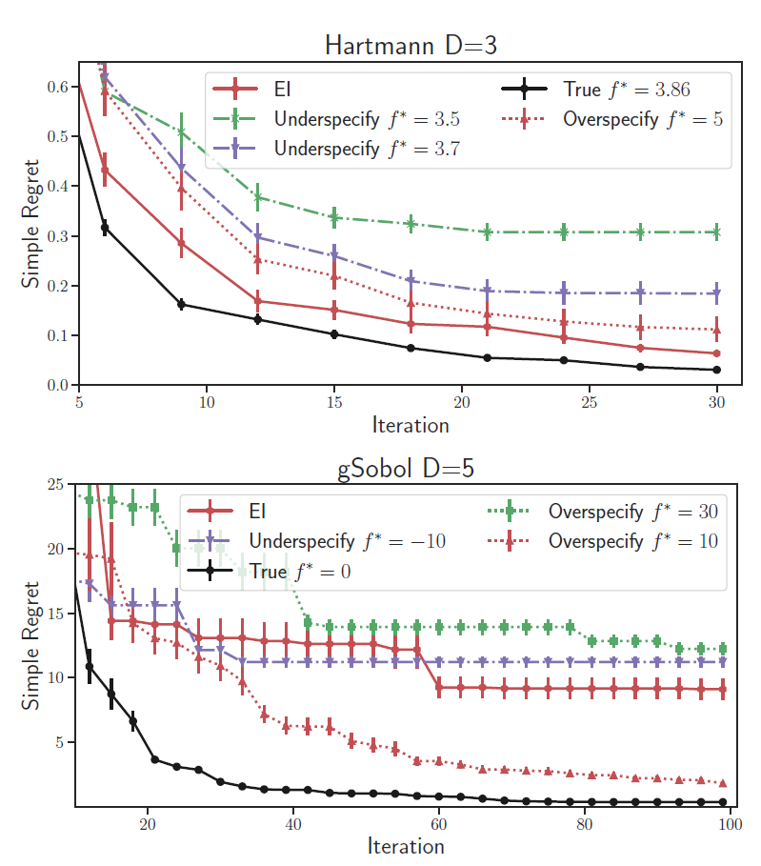
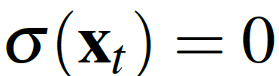
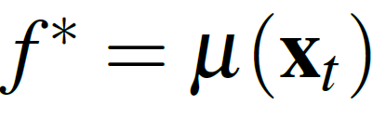
Experiment – misspecify the optimum value
setting the f* to a value which is not the true optimum of the black-box function
under-specifying case will result in worse performance than over-specifying because our acquisition function will get stuck at the area once being found wrongly as the optimal
over-specify f*,our algorithm continues exploring to find the optimum because it can not find the point where both conditions are met and

Slide 15
Conclusion
Considered a new setting in Bayesian optimization with known optimum output
Proposed transformed Gaussian process to model the objective function better by exploiting the knowledge of f*
Proposed two decision strategies which can exploit the function optimum value to make informed decisions
Know the true value f*, ERM can converge quickly to the optimum in benchmark functions and real-world applications
Do not know the exact f* value, the performance of our approach is degraded, should use the existing BO approaches (such as EI) for the best performance
Expand proposed algorithm to handle batch setting for parallel evaluations
Extend this work to other classes of surrogate functions such as Bayesian neural networks and deep GP

Slide 16
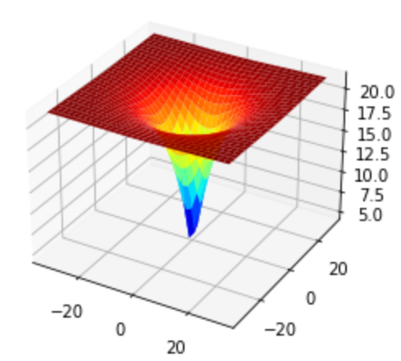
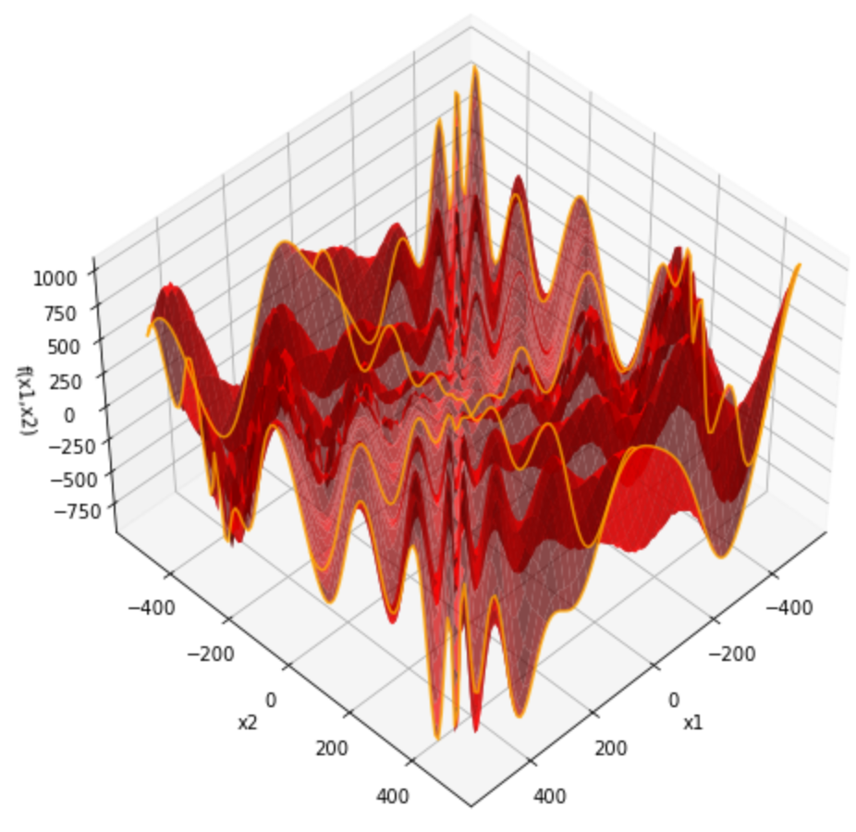
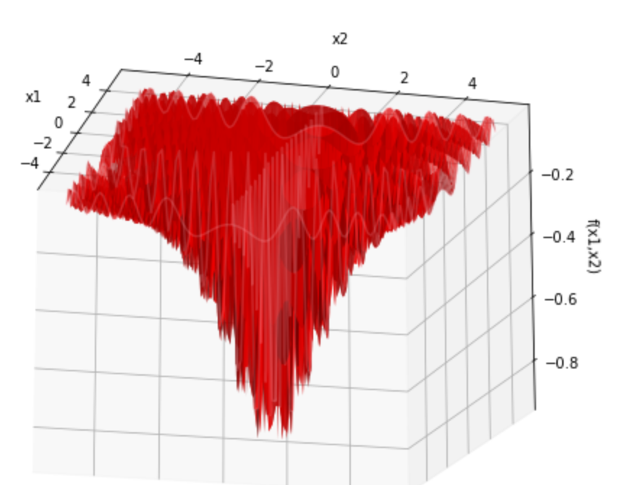
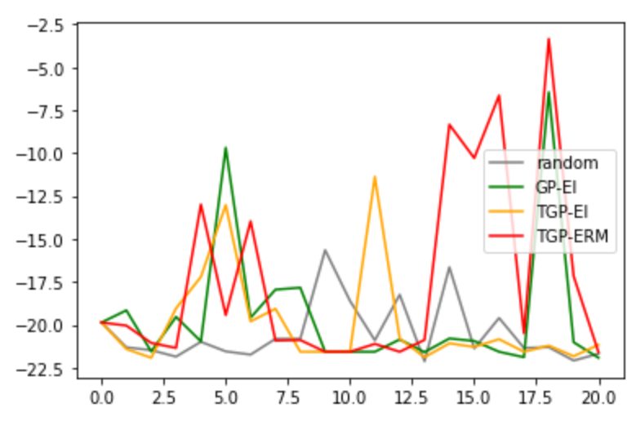
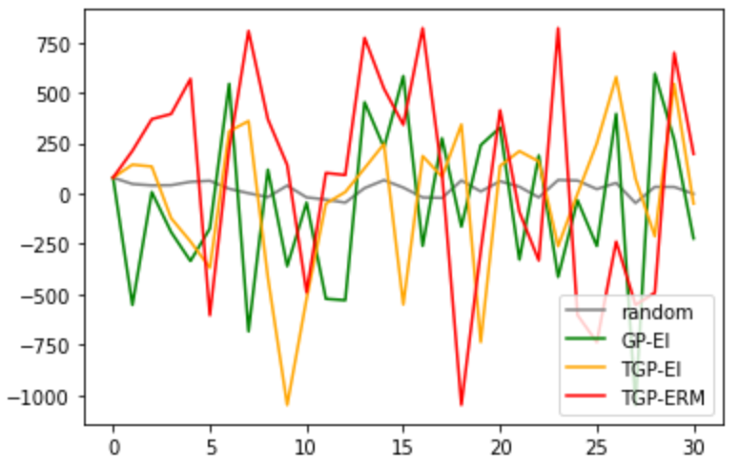
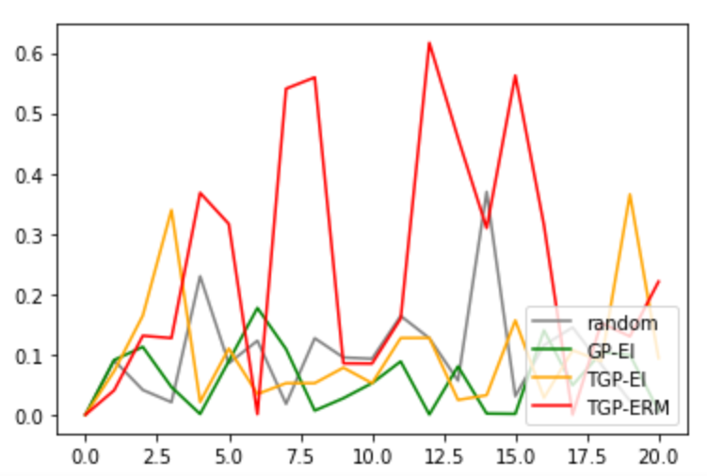
Demo - Other Benchmark Functions (2-D)
Ackley (minimization)
f* = 0
x* = (0,0)
20 iterations
Eggholder (minimization)
f* = -959.6407
x* = (512, 404.2319)
30 iterations
Drop Wave (minimization)
f* = -1
x* = (0, 0)
20 iterations
Notes:
0712回饋
多一點init 點
改圖表示方法 (當前最優值)
再比較其他acquisition function (較常用UCB)
CHECK 程式初始GP
到目標值差值的停止機制
Benchmark func. 參數可再多

